Slide 1
Microprocessor – Intro!
Md. Atiqur Rahman Ahad

Slide 2
Introduction to Microcontrollers
Parts of computer: CPU, memory, I/O
CPU: Control and data path
Memory: Stores instruction and data
Input/output: Interact with the outside of computers

Slide 3
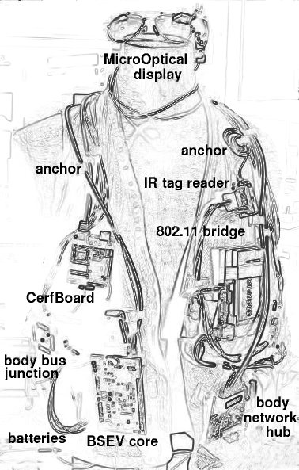
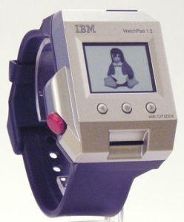
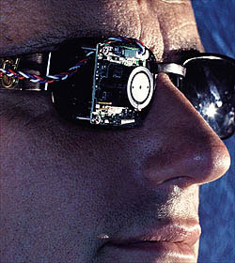
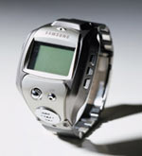
Why Study Microprocessor Design?
Notes:
Examples of why you want low-power solutions.
Here are two wristwatches, one from IBM which runs Linux and one from Samsung which is the world’s smallest cellphone. It is voice-controlled and also works as a watch!
Here are two prototype devices for helping blind people to see. The upper one is a system which converts visual data into sounds. The special glasses contain a miniature camera and the computer in the backpack convert the visual images into a sound picture which enable the wearer to see in a very useful way. In this example, the lady is able to pinpoint the location of her stick and pick it up purely by interpreting the sound signals she receives.
Below is a more sophisticated and altogether more scary system. This one also builds a camera into a special pair of glasses but them feeds the signals directly into an implant in the visual cortex in the brain. I didn’t include the pictures of that bit because they made me a bit queasy!
Finally, a research project which is currently going on at MIT in the States to build a complete wearable computing platform, complete with wireless connections, optical sensors and displays and so on. It doesn’t look up to much and you wouldn’t win any fashion awards in it but they do say that it looks very nice when built into a smart blue shirt.

Slide 4
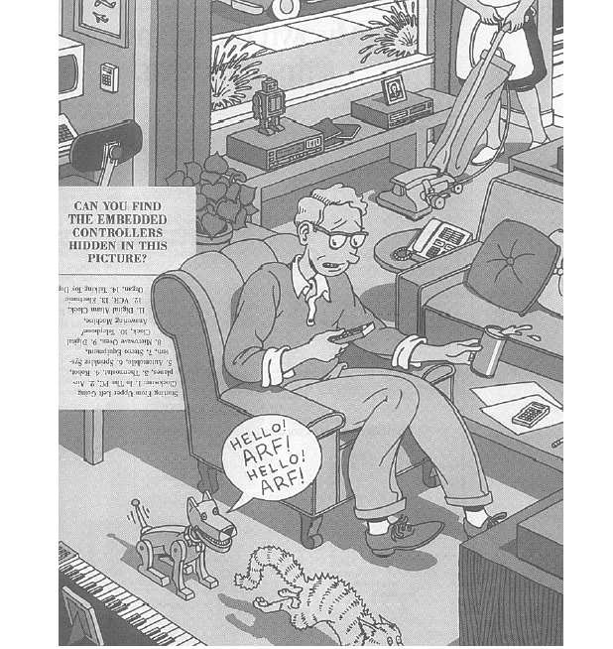
Microprocessors
are everywhere
in our life.

Slide 5
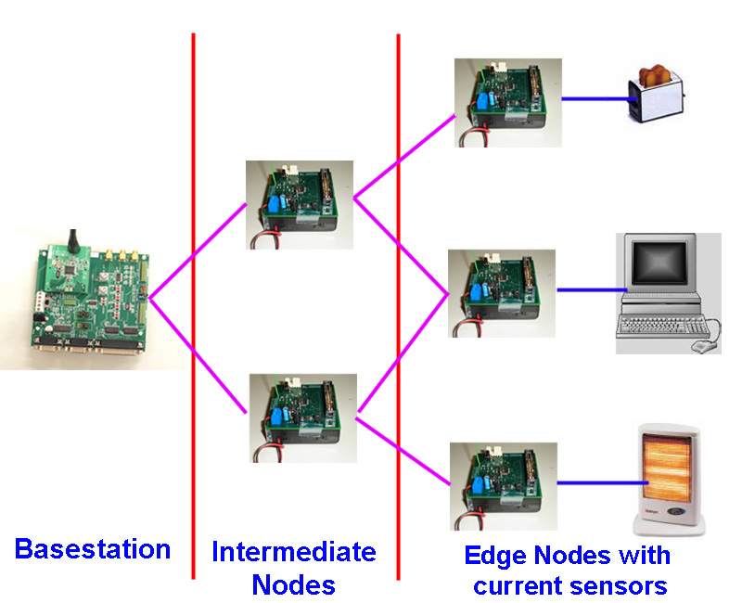
Why Study Microprocessor Design?
Wireless Sensor Networks Platform
Power Metering Application

Slide 6
Microcontrollers vs. Microprocessors
A microprocessor is a CPU on a single chip.
If a microprocessor, its associated support circuitry, memory and peripheral I/O components are implemented on a single chip, it is a microcontroller.
HW. Find 10 differentiating points.

Slide 7
Computer Technology → Dramatic Change
Processor
2X in speed every 1.5 years; 100X performance in last decade
Memory
DRAM capacity: 2X / 2 years; 64X size in last decade
Cost per bit: improves about 25% per year
Disk
capacity: > 2X in size every 1.0 years
Cost per bit: improves about 100% per year
250X size in last decade

Slide 8
Computer Technology → Dramatic Change!
State-of-the-art PC (at least…)
Processor clock speed: 5000 MegaHertz (5.0 GigaHertz)
Memory capacity: 4000 MegaBytes (4.0 GigaBytes)
Disk capacity: 2000 GigaBytes (2.0 TeraBytes)
New units! Mega => Giga, Giga => Tera
(Kilo, Mega, Giga, Tera, Peta, Exa, Zetta, Yotta = 10²⁴)
Kilo, Mega, etc. are incorrect Terminologies!

Slide 9
Processor Performance
CPU Time
= # Cycles × Cycle Time
= # Instructions × CPI × Cycle Time
CPI: Cycles per instruction

Slide 10
Microprocessor Architecture
The MPU communicates with Memory and I/O using the System Bus
Address bus
Unidirectional
Memory and I/O Addresses
Data bus
Bidirectional
Transfers Binary Data and Instructions
Control lines
Read and Write timing signals

Slide 11
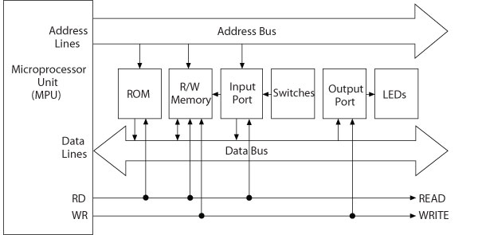
Microprocessor-Based System

Slide 12
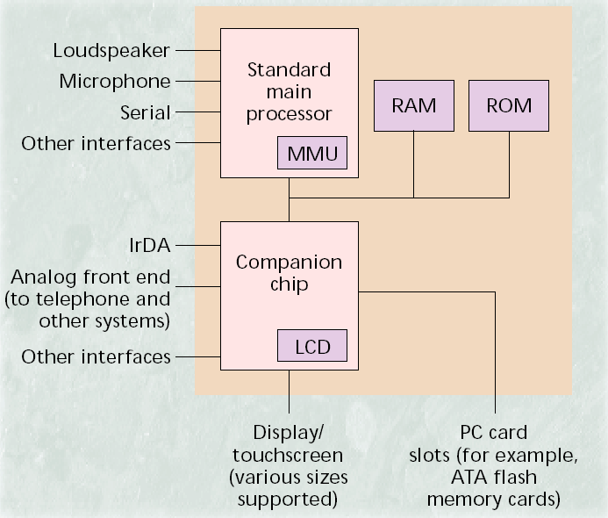
System on a Chip Example
Hand Held PC

Slide 13
Microprocessor
Data
Cache
Memory
Bus
Control
Unit
Arithmetic
& Logic
Unit
RAM
Bus
Interface
Unit
I/O
Instruction
Decoder
Registers
System
Bus
Floating
Point
Unit
Instruction
Cache
Registers

Slide 14
Bus Interface Unit
Receives instructions & data from main memory
Instructions are then sent to the instruction cache, data to the data cache
Also receives the processed data and sends it to the main memory

Slide 15
Instruction Decoder
This unit receives the programming instructions and decodes them into a form that is understandable by the processing units, i.e. the ALU or FPU
Then, it passes on the decoded instruction to the ALU or FPU

Slide 16
Data
Cache
Memory
Bus
Arithmetic
& Logic
Unit
RAM
Bus
Interface
Unit
I/O
Instruction
Decoder
Registers
System
Bus
Floating
Point
Unit
Instruction
Cache
Registers

Slide 17
Arithmetic & Logic Unit (ALU)
It performs whole-number math calculations (subtract, multiply, divide, etc.), comparisons (<, >, etc.) and logical operations (NOT, OR, AND, etc.)
The new breed of popular microprocessors have not one but two almost identical ALU’s that can do calculations simultaneously, doubling the capability

Slide 18
Floating-Point Unit (FPU)
Also known as the “Numeric Unit”
It performs calculations that involve numbers represented in the scientific notation (floating-point numbers).
This notation can represent extremely small and extremely large numbers in a compact form
Floating-point calculations are required for doing graphics, engineering and scientific work
The ALU can do these calculations as well, but will do them very slowly

Slide 19
registrar – register – resistor
Both ALU & FPU have a very small amount of super-fast private memory placed right next to them for their exclusive use. These are called registers
The ALU & FPU store intermediate and final results from their calculations in these registers
Processed data goes back to the data cache and then to main memory from these registers

Slide 20
Control Unit
The brain of the uP
Manages the whole uP
Tasks include –
- fetching instructions & data,
- storing data,
- managing input/output devices

Slide 21
Let’s talk about the language of a uP Machine-level Execution
Machine instruction:
A bundle of binary bits with certain formats
Only asks for simple operations
Assembly: textual notations of machine program
Example:
c = a + b;
Machine execution:
r1 ← mem(a)
r2 ← mem(b)
r3 ← ADD r1, r2
mem(c) ← r3

Slide 22
Software
Assembly Language
Machine instructions represented in mnemonics
One-to-one correspondence
Efficient execution and use of memory
Machine-specific

Slide 23
Software
High-Level Languages
BASIC, C, and C++
Written in statements of spoken languages
Machine independent
Easy to write and troubleshoot
Larger memory and less efficient execution

Slide 24
Instruction Set
Set of machine instructions that a uP recognizes & can execute – the only language uP knows
An instruction set includes low-level, a single step-at-a-time instructions, such as add, subtract, multiply, and divide
Each uP family has its unique instruction set
➔ bigger instruction-sets
more complex chips
(higher costs, reduced efficiency)
➔ but shorter programs

Slide 25
History a bit

Slide 26
The 1st uP: Intel 4004
Introduced Nov., 1971 by Intel
2250 transistors
108 kHz, 60,000 ops/sec
16 pins DIP (Dual in-line package)
10-micron process
Targeted use: Calculators
Instruction set: 46 instructions (of which 41 were 8 bits wide and 5 were 16 bits wide)
Cost: less than $100

Slide 27
Why Intel came up with the idea?
A Japanese calculator manufacturer – Busicom – wanted Intel to develop 16 separate IC’s for a line of new calculators
Intel, at that point in time known only as a memory manufacturer, was quite small and did not have the resources to do all 16 chips
Ted Hoff came up with the idea of doing all 16 on a single chip
Later, Intel realized that the 4004 could have other uses as well

Slide 28
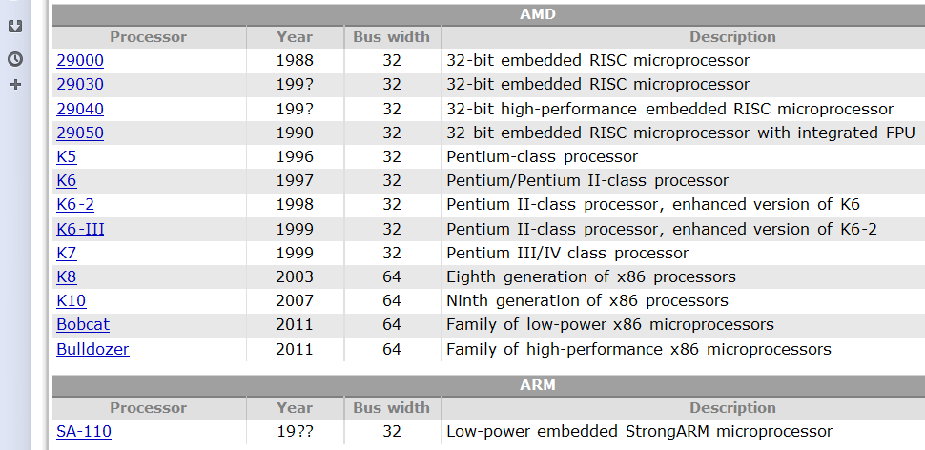
CPU families…
http://www.cpu-world.com/CPUs/CPU.html

Slide 29
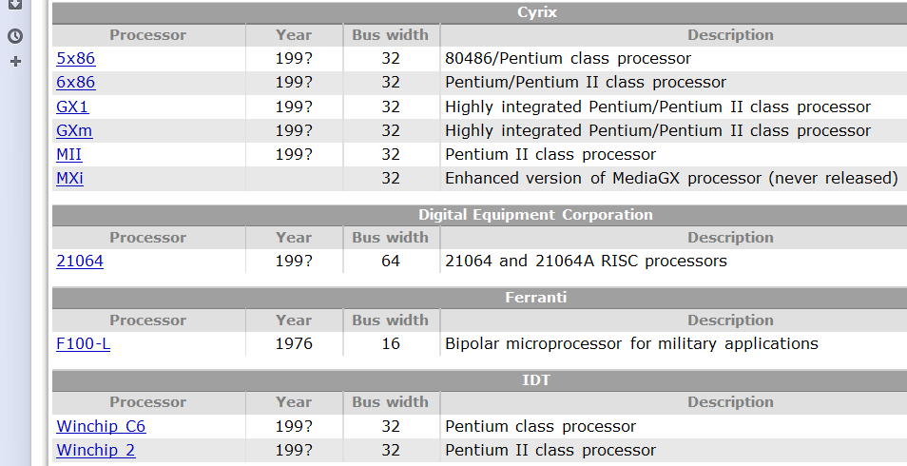

Slide 30
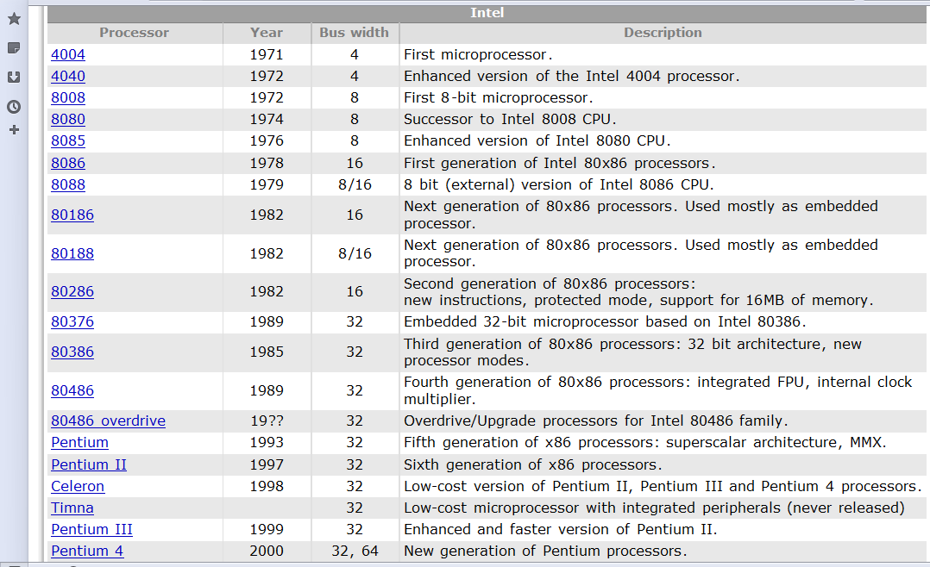

Slide 31
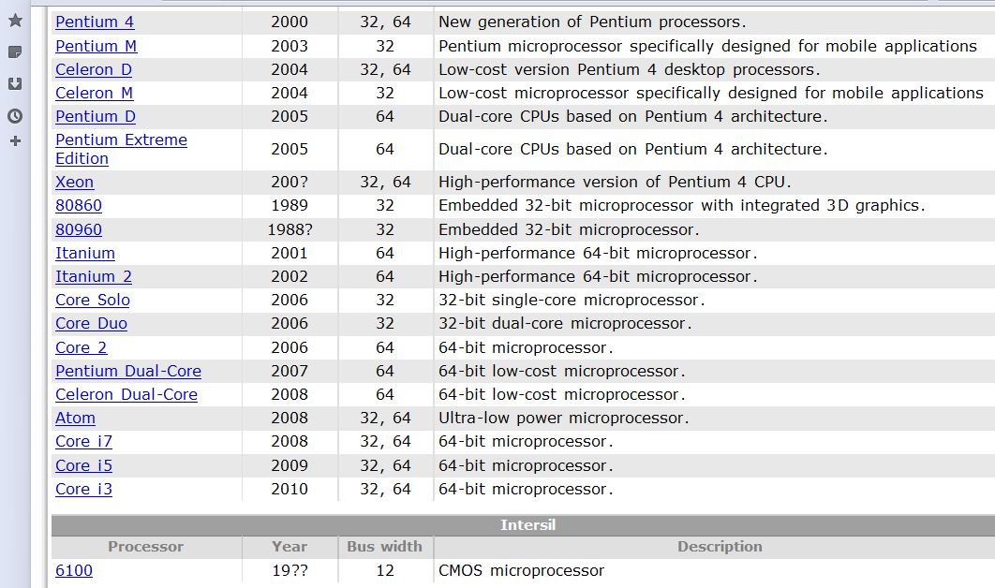

Slide 32
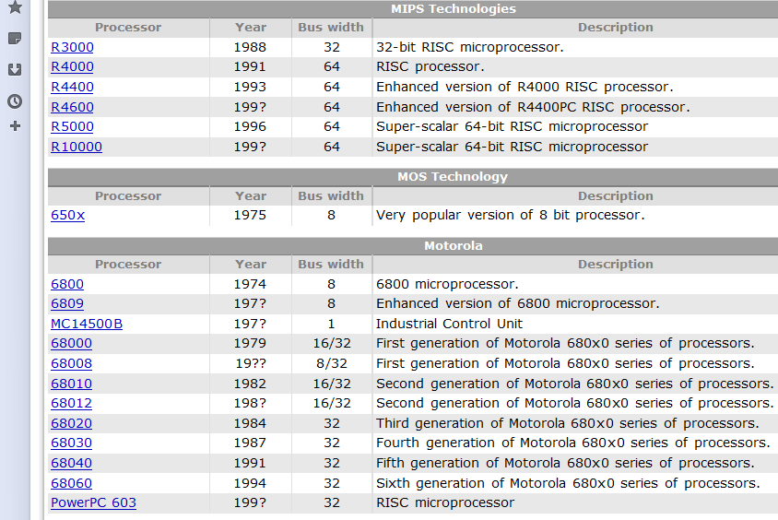

Slide 33
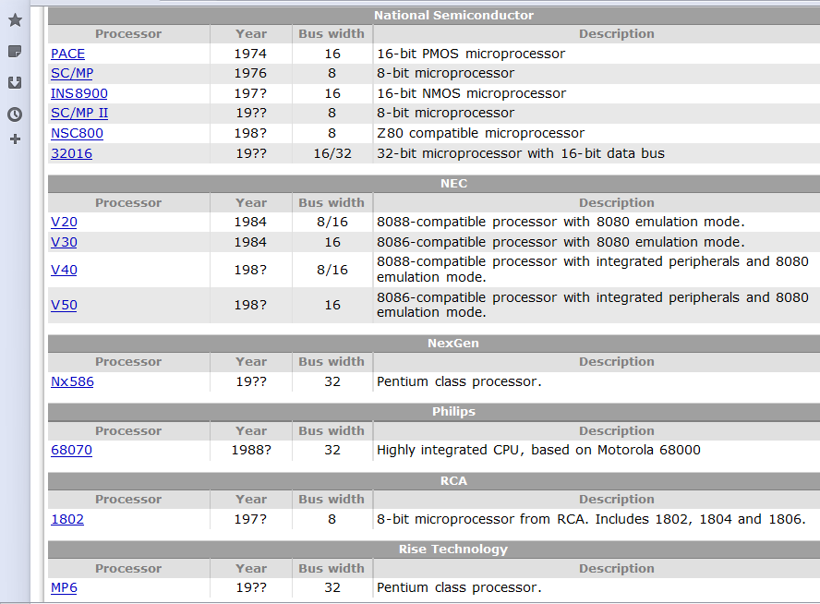

Slide 34
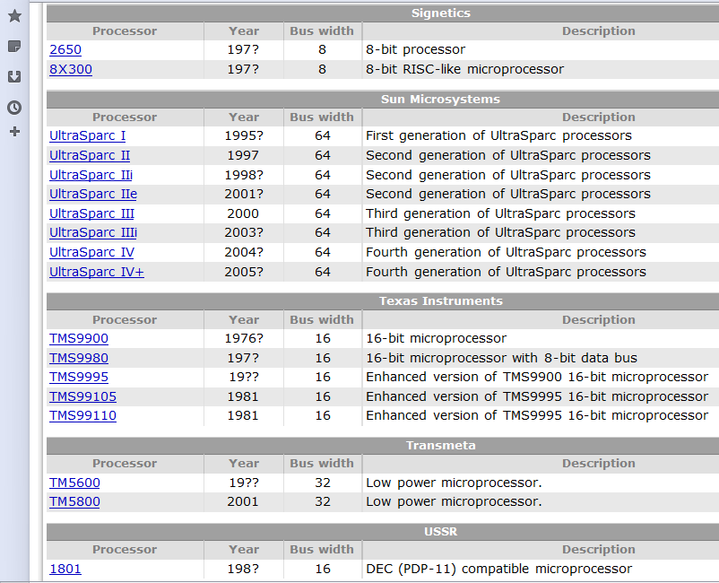

Slide 35
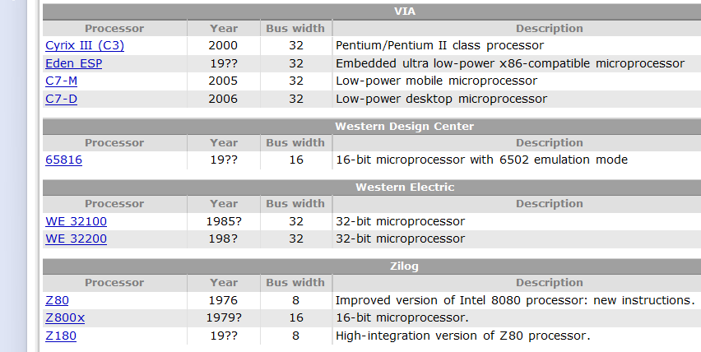

Slide 36
4004
» 1st 4-bit microprocessor
» 740 KHz
» 4 KB program memory
» 640 bytes data memory
» 3-level deep stack
» No interrupts
16-pin DIP
8008
» 1st 8-bit microprocessor
» Up to 800 KHz
» 16 KB memory
» 7-level deep stack
» 8 In / 24 Out ports
18-pin DIP

Slide 37
Intel 8008
Intel 8008 (i8008) was released 5 months after Intel 4004.
8008 was available in two speed grades - 500 KHz and 800 KHz.
Because it took the CPU from 5 to 8 cycles to execute each instruction, the effective rate of instruction execution was:
From 45,000 to 100,000 instructions per second for Intel 8008
From 72,000 to 160,000 instruction per second for Intel 8088-1

Slide 38
Overall performance of the i8008 was greater due to
- faster effective speed of some instructions,
- 8-bit architecture and
- more efficient instruction set.
The 8008 had other advantages over the 4004:
The processor supported of 16 KB of memory (ROM and RAM combined).
The size of internal CPU stack was 7 levels in contrast to 3 level-stack for the i4004.
The Intel 8008 could handle interrupts.

Slide 39
Drawbacks:
Absence of direct memory addressing. To access data in memory the memory address had to be stored in H and L registers, and only then the processor could indirectly access the memory.
This limitation was removed in Intel 8080.
Intel 8008 microprocessor was used in Mark-8 computer, which is considered to be the 1st personal computer.

Slide 40
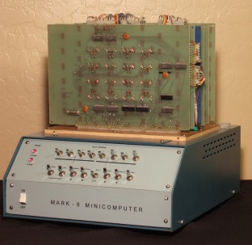
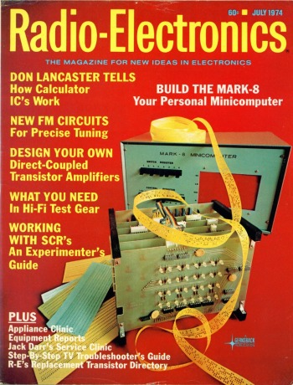
Mark-8!

Slide 41
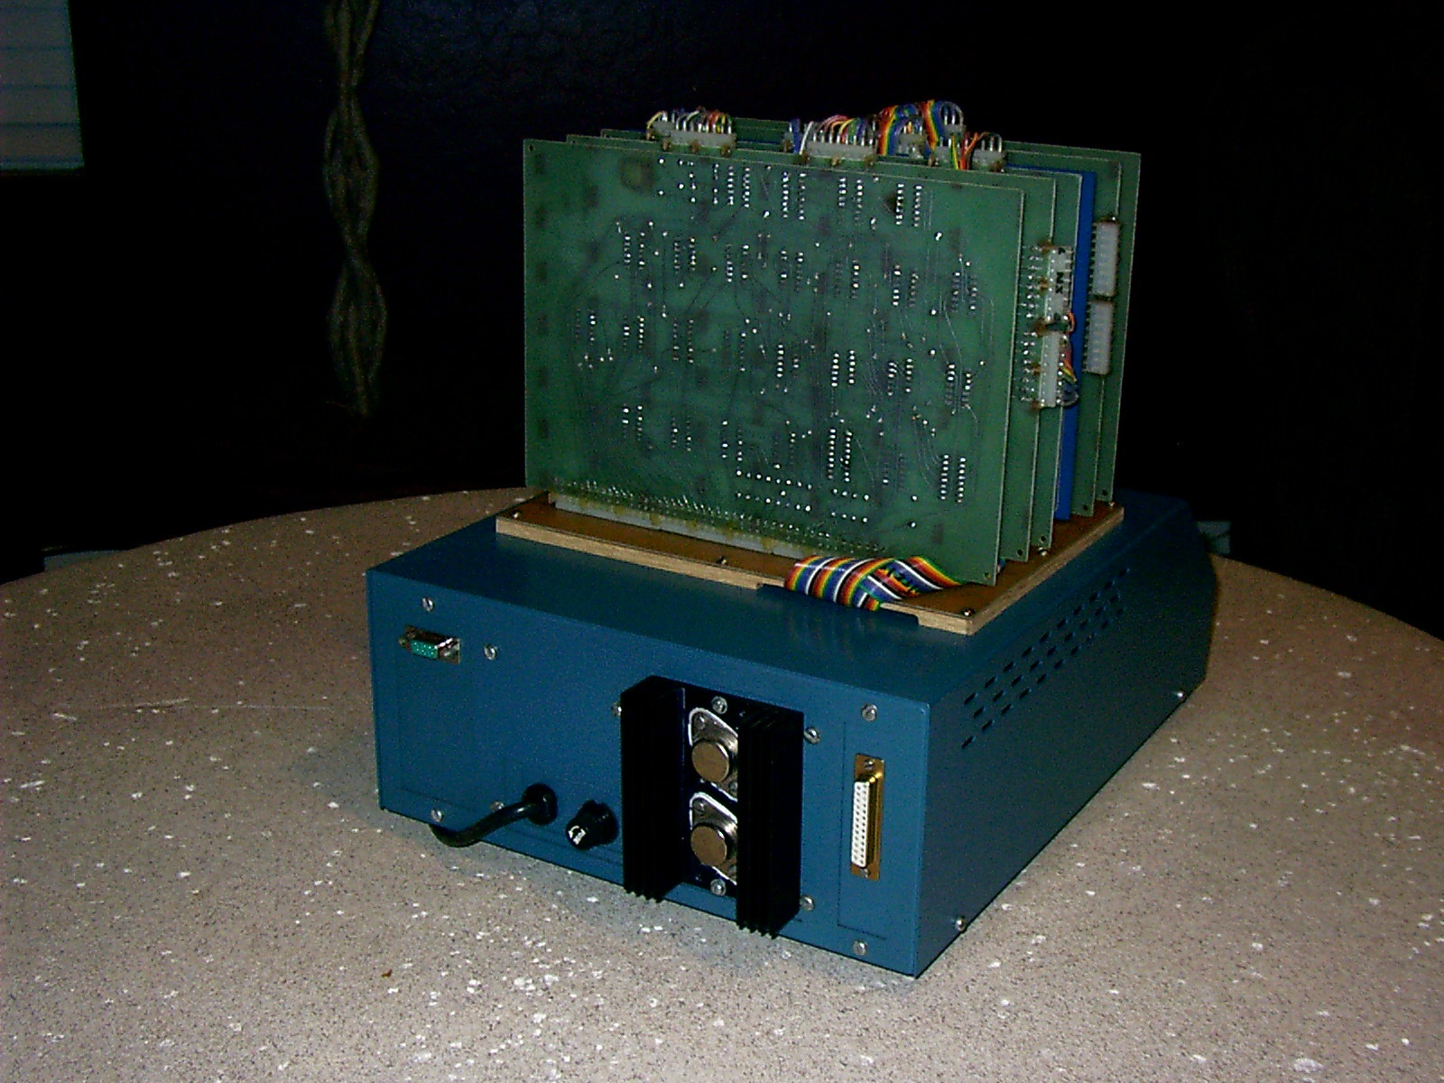

Slide 42
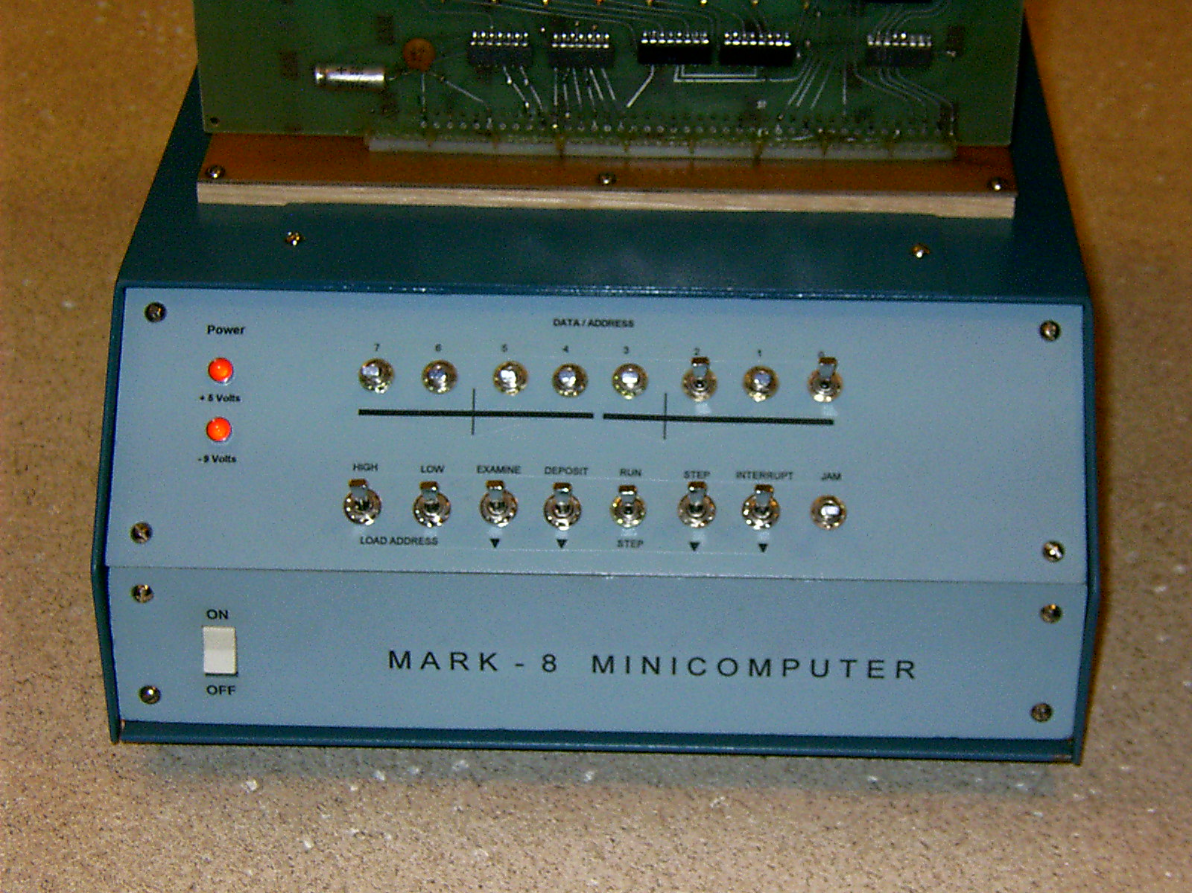

Slide 43
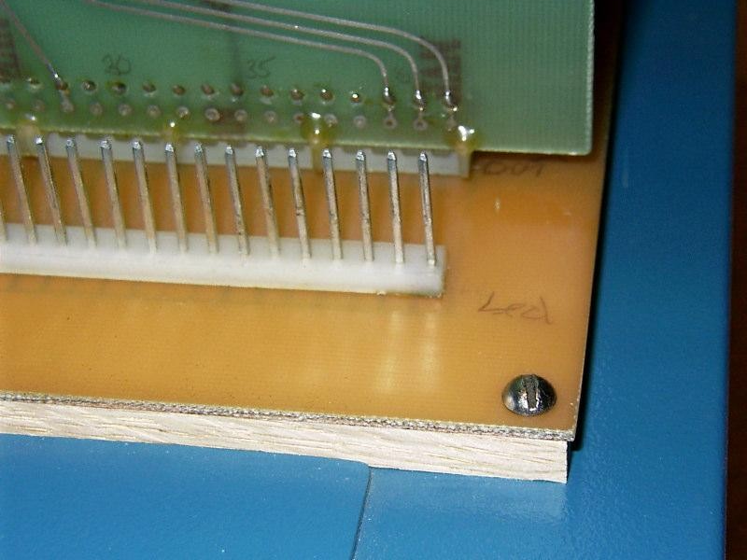

Slide 44
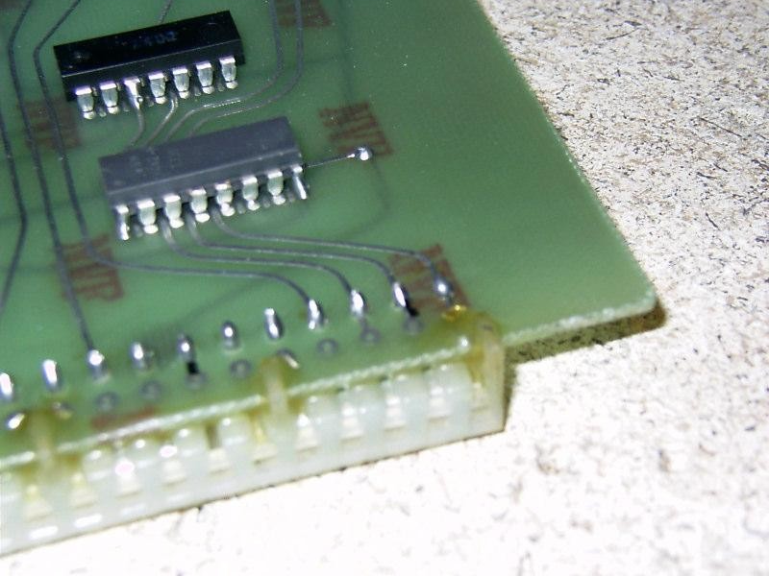
http://www.bytecollector.com/mark_8.htm

