Slide 1
Microcontroller – 2 PIC

Slide 2
Various companies
Freescale semiconductor’s –x Motorola] 68HC11
Intel – 8051
Atmel – AVR
Zilong – Z8
Microchip technology – PIC
etc.

Slide 3
PIC – Peripheral Interface Controller by Microchip Tech. Corp.
Peripheral?
Interface?
Controller?

Slide 4
PIC Microcontrollers
Peripheral Interface Controller (PIC) was originally designed by General Instruments
In the late 1970s, GI introduced PIC® 1650 and 1655 – RISC with 30 instructions.
PIC was sold to Microchip
Features: low-cost, self-contained, 8-bit, Harvard structure, pipelined, RISC, single accumulator, with fixed reset and interrupt vectors.

Slide 5
PIC Families
PIC Family | Stack Size | Instruction Word Size | No of Instructions | Interrupt Vectors
12CX/12FX | 2 | 12- or 14-bit | 33 | None
16C5X/16F5X | 2 | 12-bit | 33 | None
16CX/16FX | 8 | 14-bit | 35 | 1
17CX | 16 | 16-bit | 58 | 4
18CX/18FX | 32 | 16-bit | 75 | 2
‘C’ implies CMOS technology; Complementary Metal Oxide Semiconductor
‘F’ insert indicates incorporation of Flash memory technology
Example: 16C84 was the first of its kind. It was later reissued as the 16F84, incorporating Flash memory technology. It was then reissued as 16F84A.

Slide 6
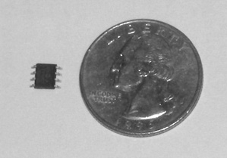
12 Series PIC
The small 12F508

Slide 7
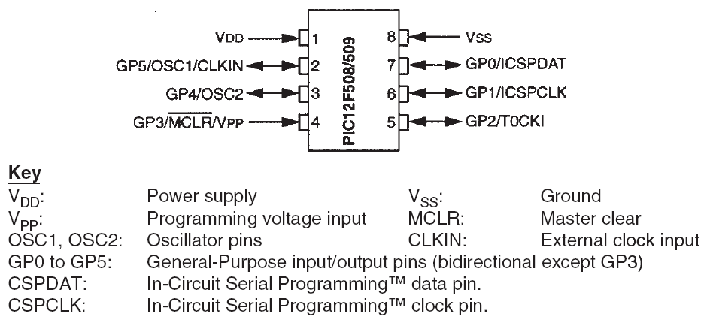
PIC 12F508/509 pin connection diagram

Slide 8
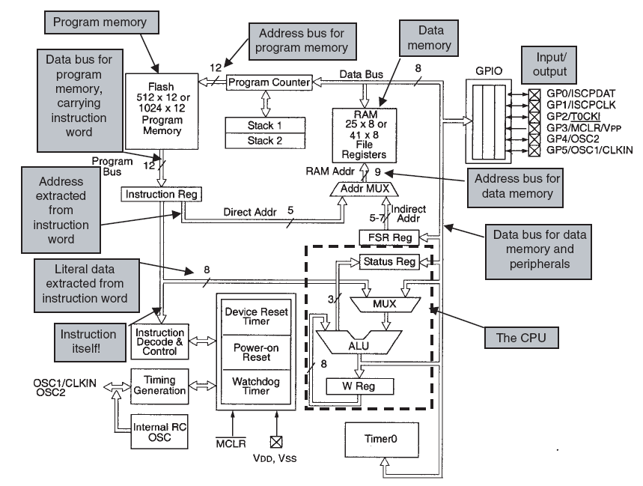
The 12F508 Architecture

Slide 9
Microchip is the no. 1 supplied of 8-bit microcontrollers!
8 pins
Small Data RAM
Few hundred bytes of on-chip (program [code]) ROM
One timer
Few pins for I/O ports
8-bit processor – CPU can work on only 8-bits of data at a time
Q: if data is larger than 8 bits?
→ Break it into 8-bit pieces to be processed by the CPU

Slide 10
PIC… - Upwardly compatible in terms of software, when going from one family to another family?
Not always – prob!
E.g.,
PIC12xxx has 12-bit wide instructions
PIC16xxx has 14-bit wide instructions
PIC18xxx has 16-bit wide instructions & many new instructions
*So, to run a prog in PIC18 – but written for PIC12
– we MUST recompile the prog, &
– possibly change some register locations before loading it into the PIC18.

Slide 11
PIC18xxx
Highest-performance 8-bit microcontroller
~ 18- to 80-pin packages
Now, no 8-pin versions of PIC18 [others have]
Q. RISC or CISC architecture?
RISC!

Slide 12
PIC18
RISC
Data RAM
On-chip (program [code]) ROM
Data EEPROM - Q. What is EEPROM?
I/O ports
Peripherals – e.g.,
Timers
ADC – Q. What is ADC?
USART - Universal Asynchronous Receiver/Transmitter

Slide 13
Read
Simplified view of a PIC microcontroller
PIC18, PIC16 block diagrams

Slide 14
ROM – why?
To store programs
– hence, called program/code ROM
PIC18 has 2MB of prog ROM space
This ROM type may be of –
Flash
OTP
Masked
[more in Ch. 14]

Slide 15
PIC mcc with UV-EPROM
Need PROM burner
Need UV-EPROM eraser to erase the contents of ROM
The window of the U…M chip allows the UV light to erase the roM
~20min to erase the chip before it can be programmed again
hence, need flash version of the PIC family
[see Table 1-2]

Slide 16
PIC18Fxxx with flash memory
F – for flash
Flash version can erase in seconds
Need a ROM burner that supports flash mem
But a ROM eraser is not needed, as flash is an EEPROM [electrically-

Slide 17
An embedded system is a product that has one or more computers embedded within it, which exercise primarily a control function.
The embedded computer is usually a microcontroller: a microprocessor adapted for embedded control applications.
Microcontrollers are designed according to accepted electronic and computer principles, and are fundamentally made up of microprocessor core, memory and peripherals.

Slide 18
Microchip offers a wide range of microcontrollers, divided into a number of different families. Each family has identical central architecture and instruction set. However, common features also appear across all their microcontrollers.
The Microchip 12F508 is a good microcontroller to introduce a range of features of microcontrollers in general and of PIC microcontrollers in particular.

