Slide 1
Ch. 5 – Intel 8086 – study details from Yu & Marut

Slide 2
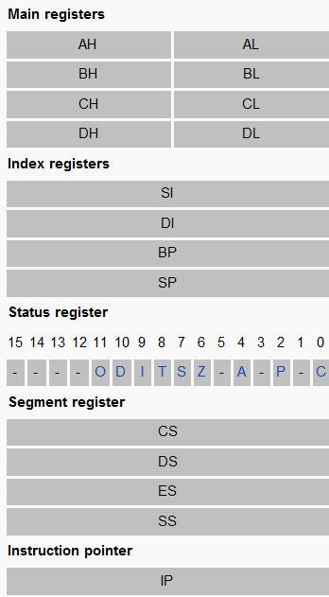

Slide 3
Registers
(16-bit) registers:
Data reg. – to hold data for an op.
Address reg – to hold addr of an instruction or data
Status reg / FLAGS reg

Slide 4
3. Status Reg./FLAGS reg.
To indicate the status of the mP.
1 flag == 1 bit
Y/N
9 active bits – out of ?? Bits?
Q: Types of flags? Some names?
Control flags – interrupt flag, trap flag, direction flag
Status flags – Zero flag, Carry flag, sign flag, parity, auxiliary flag, overflow flag

Slide 5
Status flags
Processor uses the status flags to reflect the result of an operation.
E.g.,
SUB AX, AX
Zero flag becomes 1
It indicates that a zero result was produced

Slide 6
Carry flag - CF
CF = 1
➔ if there is a carry out from the MSB on addition;
or, there is a borrow into the MSB on subtraction;
Else CF = 0
CF changes with SHIFT (SHL – shift left; SAL – shift arithmetic left; SHR – shift right; SAR – shift arithmetic right) &
ROTATE (ROL – rotate left; ROR – rotate right) instructions
→ Read – chapter 7

Slide 7
Parity flag - PF
PF = 1
If the low byte of a result has an even number of one bits [even parity]
PF = 0
If the low byte has odd parity
Q.: If after ADD – the result is FFFEh – then the low byte [FE] contains 7 one bits [FE = 1111 1110], PF = ?
Ans.: PF = 1
➔ Nooooooo… ➔ PF = 0

Slide 8
Auxiliary Carry Flag - AF
AF = 1
If there is a carry out from bit 3 on addition,
Or a borrow into bit 3 on subtraction
AF is used in BCD operations [see ch. 18]
BCD – Binary-Coded Decimal [BCD uses 4 bits to code each decimal digit, from 0000 to 1001.
Combination of 1010 to 1111 are illegal in BCD.

Slide 9
Zero flag - ZF
ZF = 1
For a zero result
ZF = 0
→ For a nonzero result

Slide 10
Sign flag - SF
SF = 1
If the MSB of a result is 1
It means the result is negative if you are giving a signed interpretation
SF = 0
→ If the MSB is 0

Slide 11
Overflow flag - OF
OF = 1
If signed overflow occurred
16 bits: singed: range: -32768 ~ 32767
unsinged: 0 ~ 65535
8 bits: signed: -128 ~ 127
unsigned: 0 ~ 255

Slide 12
Unsigned overflow
What is overflow?
exa of unsigned overflow but not singed overflow
e.g.,
AX = FFFFh ➔ 16 bits
BX = 0001h ➔ 16 bits
ADD AX, BX
Result: 1 0000 0000 0000 0000 ➔ 17 bits, not 16 bits
So, AX = 0000 0000 0000 0000 = 0000h
So, unsigned overflow occurred.

Slide 13
If unsigned interpretation – then Answer ➔ 10000h = 65536 → but 17 bits
In 16 bits ➔ AX = 0000h is the result! – WRONG! An unsigned overflow occurred.
BUT the answer is CORRECT for a signed number –
FFFFh = -1
0001h = 1
FFFFh + 0001h = -1 + 1 = 0
➔ so, singed overflow did not occur.

Slide 14
Signed OF, not unsigned OF
AX = 7FFFh
BX = 7FFFh
ADD AX,BX
So, AX = 1111 1111 1111 1110 = FFFEh = 65534
This is out of range for signed nos.
So, singed OF occurs
But for unsinged no., it is ok.

Slide 15
Q.
Questions are then –
How does the CPU indicate overflow?
How does it know that overflow occurred?

Slide 16
1. How does the CPU indicate overflow?
CPU sets OF = 1 for signed OF
CPU sets CF = 1 for unsigned OF
It is the Programmer who interpret the results.
If a signed interpretation is being given, then only OF is of interest & CF can be ignored.
If unsigned? → CF is important, but not OF.

Slide 17
2. How CPU knows that overflow occurred?
Many instructions can cause overflow, e.g., ADD, SUB

Slide 18
For unsigned overflow
ADD: unsigned overflow occurs when there is a carry out of the MSB. [i.e., if result is larger than the capacity].
SUB: … when there is a borrow into the MSB. [i.e., the correct answer is smaller than 0]

Slide 19
For signed overflow
ADD: On addition of nos. with the same sign, signed overflow occurs when the sum has a different sign.
E.g., 7fffh + 7fffh = fffeh = 1111……0
→ It is a negative result.

Slide 20
For signed overflow…
SUB: Subtraction of 2 nos. of different signs – means adding nos. of same sign.
E.g., A – (-B) = A + B. -A – (+B) = -A + -B
Signed overflow occurs if the result has a different sign than expected. ➔ exa. 5.3.
But, if ADD of nos. of different signs – overflow is impossible.
A + (-B) = A – B → Result is smaller than A or B. No chance for overflow.
Likewise, SUB of nos. of same signs → no overflow

Slide 21
Exa. 5.3
AX = 8000h [neg. no.] BX=0001h
SUB AX,BX
8000h – 0001h = 7fffh = 0111111111111111
CF = 0 → as a smaller unsigned no. is being subtracted from a larger one.
OF? →
OF: in a singed sense, subtracting from a positive no. (BX) from a negative no. (AX) → means adding 2 negatives [-A – B = -A + (-B)]. Result is Positive (wrong sign) , OF = 1
Convert these into decimal and see.

Slide 22
Actually, the processor uses this method to set the OF:
If the carries into and out of the MSB doesn’t match – i.e., there is a carry into the MSB but no carry out, or,
If there is a carry out but no carry in – then signed overflow is occurred, & OF is set to 1.
----- see exa. 52.

Slide 23
Exa. 5.2:
AL = 80h BL = 80h
ADD AL,BL
80h + 80h = 1 00h
So, AL = 00h
CF = 1: as there is a carry out of MSB
OF = 1: as both nos. are negative [80h=10000000], but the result = 00h (as binary addition, there is no carry into the MSB, but there is a carry out)

Slide 24
How instructions affect the flags?
Usually, each time a mP executes an instruction – the flags are altered to reflect the result
JMP [jump] instr. depend on the flags settings
MOV/XCHG none [no change]
ADD/SUB all
INC/DEC all except CF

Slide 25
Q.: ADD AX, BX
AX = FFFFh
BX = FFFFh
So, after ADD, AX = 1 FFFEh
So inside …

