Slide 1
Stack

Slide 2
Abstract Stack
3.2.1
An Abstract Stack (Stack ADT) is an abstract data type which emphasizes specific operations:
Uses a explicit linear ordering
Insertions and removals are performed individually
Inserted objects are pushed onto the stack
The top of the stack is the most recently object pushed onto the stack
When an object is popped from the stack, the current top is erased

Slide 3
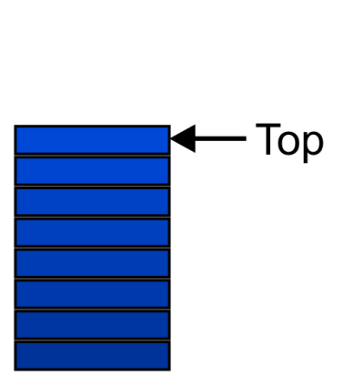
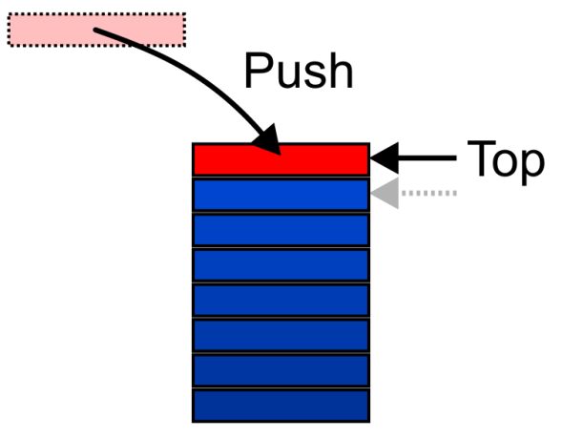
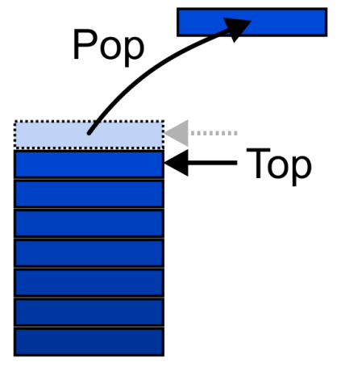
Abstract Stack
3.2.1
Also called a last-in–first-out (LIFO) behaviour
Graphically, we may view these operations as follows:
There are two exceptions associated with abstract stacks:
It is an undefined operation to call either pop or top on an empty stack

Slide 4
Applications
3.2.2
Numerous applications:
Parsing code:
Matching parenthesis
XML (e.g., XHTML)
Tracking function calls
Dealing with undo/redo operations
Reverse-Polish calculators
Assembly language
The stack is a very simple data structure
Given any problem, if it is possible to use a stack, this significantly simplifies the solution

Slide 5
Implementations
3.2.3
We will look at two implementations of stacks:
The optimal asymptotic run time of any algorithm is Θ(1)
The run time of the algorithm is independent of the number of objects being stored in the container
We will always attempt to achieve this lower bound
We will look at
Singly linked lists
One-ended arrays

Slide 6
Linked-List Implementation
3.2.3.1
Operations at the front of a singly linked list are all Θ(1)
The desired behaviour of an Abstract Stack may be reproduced by performing all operations at the front
 | Front/1st | Back/n^{th}
Find | Θ(1) | Θ(1)
Insert | Θ(1) | Θ(1)
Erase | Θ(1) | Θ(n)

Slide 7
Pop
3.2.3.2
Removing an object simply involves reducing the size
It is invalid to assign the last entry to “0”
By decreasing the size, the previous top of the stack is now at the location stack_size
pop() {
if ( empty() ) {
throw underflow();
}
--stack_size;
return array[stack_size];
}
Notes:
7

Slide 8
Push
3.2.3.2
Pushing an object onto the stack can only be performed if the array is not full
push( Type const &obj ) {
if ( stack_size == array_capacity ) {
throw overflow(); // Best solution?????
}
array[stack_size] = obj;
++stack_size;
}

Slide 9
Exceptions
3.2.3.2
The case where the array is full is not an exception defined in the Abstract Stack
If the array is filled, we have five options:
Increase the size of the array
Throw an exception
Ignore the element being pushed
Replace the current top of the stack
Put the pushing process to “sleep” until something else removes the top of the stack

Slide 10
Function Calls
3.2.5.3
This next example discusses function calls
See how stacks are implemented in hardware on all CPUs to facilitate function calling
The simple features of a stack indicate why almost all programming languages are based on function calls

Slide 11
Function Calls
3.2.5.3
Function calls are similar to problem solving presented earlier:
you write a function to solve a problem
the function may require sub-problems to be solved, hence, it may call another function
once a function is finished, it returns to the function which called it

Slide 12
Function Calls
3.2.5.3
You will notice that the when a function returns, execution and the return value is passed back to the last function which was called
This is again, the last-in—first-out property
Today’s CPUs have hardware specifically designed to facilitate function calling

Slide 13
References
Donald E. Knuth, The Art of Computer Programming, Volume 1: Fundamental Algorithms, 3rd Ed., Addison Wesley, 1997, §2.2.1, p.238.
Cormen, Leiserson, and Rivest, Introduction to Algorithms, McGraw Hill, 1990, §11.1, p.200.
Weiss, Data Structures and Algorithm Analysis in C++, 3rd Ed., Addison Wesley, §3.6, p.94.
Wikipedia, http://en.wikipedia.org/wiki/Stack_(abstract_data_type)
Slides from: “These slides are provided for the ECE 250 Algorithms and Data Structures course. The material in it reflects Douglas W. Harder’s best judgment in light of the information available to him at the time of preparation. Any reliance on these course slides by any party for any other purpose are the responsibility of such parties. Douglas W. Harder accepts no responsibility for damages, if any, suffered by any party as a result of decisions made or actions based on these course slides for any other purpose than that for which it was intended.” from U of Waterloo

